Slide 1

Deep
Q-Networks
Presented by Taksh Nahata
Antonoglou et al.

Slide 2

The Core Problem: Discrete Choices
01.
The Mapping Challenge: Unlike steering wheels where you can turn "slightly left" by any floating-point degree, many environments require hard, discrete choices (like pressing Left, Right, Jump, or Fire).
02.
Predicting the Future: If you are in a specific state, how do you mathematically calculate the "future value" of pressing a specific button right now?
The Goal: We need a neural network that looks at a screen and outputs a score for every possible button press, so we can always pick the absolute best one.

Slide 3

The Big Idea: Q-Learning
The Q-Value: "Q" stands for quality. A Q-value is simply a prediction of the total score we will get from now until the end of the game if we take a specific action right now.
The Bellman Equation: DQN uses a classic math rule to constantly update its guesses. It says: "The value of my choice right now is the reward I get immediately, plus the maximum value I can get in the next step."
Constant Adjustments: The AI constantly plays the game, compares its predicted Q-value to the actual reward it got, and nudges its neural network to make better guesses next time.

Slide 4
The Secret Weapon: Replay Buffer
The Amnesia Problem: Usually, an AI sees a frame, learns from it once, and immediately throws it away. This makes learning highly unstable because sequential frames are too similar.
The Solution (Experience Replay): We create a giant database (the Replay Buffer) that saves everything: [State, Action, Reward, Next State].
Random Sampling: During training, instead of learning only from the last second of driving, the AI randomly grabs a random batch of memories from the database. This stops the AI from getting hyper-focused on only its recent mistakes.

Slide 5
The Stabilizer: Target Network
The Shaky Ground Problem: When updating predictions, if you use the exact same neural network to calculate both your current guess and your future goal, the network changes so fast that the goal keeps moving. It's like trying to shoot a moving target on a rollercoaster.
The Solution (Target Network): DQN keeps a clone of the neural network frozen in the background.
Periodic Syncing: The active network does the driving and learning, while the frozen "Target Network" is used only to calculate the goal values. Every few hundred steps, we copy the active brain over to update the target brain.

Slide 6
Exploration vs. Exploitation
Epsilon-Greedy Strategy: At the very start of training, the AI is 100% blind. If it only does what it "thinks" is best, it might find one safe corner and stay there forever.
The Epsilon Decay: We use a variable called Epsilon.
At the start, Epsilon is 1.0 (meaning the car takes a 100% random action to explore).
Over time, we slowly decay Epsilon down to 0.05.
By the end, the car is 95% exploiting its learned skills and only 5% blindly exploring.

Slide 7
Verification Environment: Discrete Car Racing
The Game: We use Gymnasium's CarRacing-v2 but set it to discrete action mode.
The Menu of Choices: Instead of continuous math, the car can make 5 simple choices:
Do nothing (coast)
Steer hard left
Steer hard right
Gas (accelerate)
Brake (decelerate)
The Setup: The visual CNN takes the same 96 by 96 image and predicts a Q-value for each of these 5 choices.

Slide 8
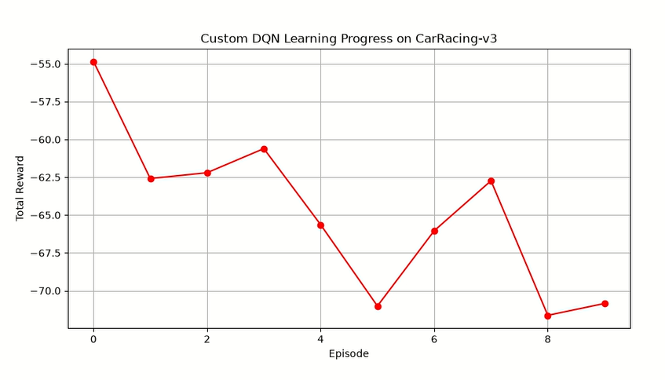
Result

Slide 9
Results Analysis
Early Exploration Drops: Starts at -55.0 but dips to -62.5 early on as the agent makes random choices to map out the track.
Temporary Breakthroughs: Spikes up to -60.5 at Episode 3 and -62.5 at Episode 7 show the CNN starting to connect correct visual inputs with positive rewards.
Exploration Dips: Sharp drops down to -71.0 (Episodes 5 and 8) show the car spinning out as it continues to randomly explore.
Next Steps: Needs a longer training run (100,000+ steps) to fully decay epsilon and let the target network stabilize.

Slide 10
Thank You

